Slide 1


Noida Institute of Engineering and Technology, Greater Noida
(An Autonomous Institute)
School of Computer Science & Engineering in Emerging Technologies
Memory Unit
Unit: 4
Computer Organization & Architecture (ACSE-0305)
AMIT YADAV
B Tech 3rd Sem
Amit Yadav Computer Organization and Architecture

Slide 2
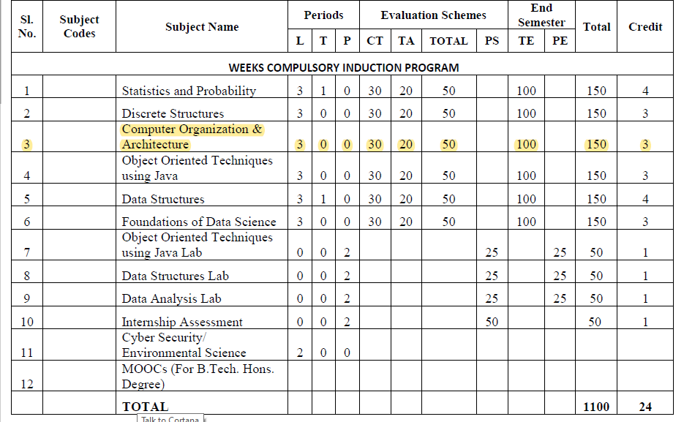
Evaluation scheme
Amit Yadav Computer Organization and Architecture

Slide 3
Subject Syllabus
Course Contents / Syllabus
UNIT-I | Introduction | 8 Hours
Computer Organization and Architecture, Functional units of digital system and their interconnections, buses, bus architecture, types of buses and bus arbitration and it’s types. Register, bus and memory transfer. Process or organization, general registers organization, stack organization and addressing modes.
UNIT-II | ALU Unit | 8 Hours
Arithmetic and logic unit: Lookahead carries adders. Multiplication: Signed operand multiplication, Booth’s algorithm and array multiplier. Division and logic operations. Floating point arithmetic operation, Arithmetic & logic unit design. IEEE Standard for Floating Point Numbers.
UNIT-III | Control Unit | 8 hours
Control Unit: Instruction types, formats, instruction cycles and sub cycles (fetch and execute etc.), microoperations, execution of a complete instruction. Program Control, Reduced Instruction Set Computer, Complex Instruction Set Computer, Pipelining. Hardwire and microprogrammed control, Concept of horizontal and vertical microprogramming, Flynn's classification.
Amit Yadav Computer Organization and Architecture

Slide 4
Subject Syllabus
Course Contents / Syllabus
UNIT-IV | Memory Unit | 8 hours
Memory: Basic concept and hierarchy, semiconductor RAM memories, 2D & 2 1/2D memory organization. ROM memories. Cache memories: concept and design issues & performance, address mapping and replacement Auxiliary memories: magnetic disk, magnetic tape and optical disks Virtual memory: concept implementation, Memory Latency, Memory Bandwidth, Memory Seek Time.
UNIT-V | Input/Output | 8 hours
Peripheral devices, I/O interface, I/O ports, Interrupts: interrupt hardware, types of interrupts and exceptions. Modes of Data Transfer: Programmed I/O, interrupt initiated I/O and Direct Memory Access. ,I/O channels and processors. Serial Communication: Synchronous & asynchronous communication.
Amit Yadav Computer Organization and Architecture

Slide 5
Branch wise Applications
Computer Science:
Understanding of Computer Organization and Architecture is required for:
Performance analysis of practical software
Parallel Software and its execution
High performance databases
Modern Compilers and Code optimization
High performance game programming
Other applications
Bio-informatics, Data science using python, Web programming
For high performance computing, we require COA background.
Amit Yadav Computer Organization and Architecture

Slide 6
Course Objective
Discuss the basic concepts and structure of computers.
Understand concepts of register transfer logic and arithmetic operations.
Explain different types of addressing modes and memory organization.
Understand the concepts of memory system and Learn the different types of memories to store data.
Explain the various types of interrupts and modes of data transfer.
Amit Yadav Computer Organization and Architecture

Slide 7
Course Outcomes
Course outcomes : After completion of this course students will be able to
CO 1 | Understand the basic structure and operation of a digital computer system | K1, K2
CO 2 | Analyze the design of arithmetic & logic unit and understand the fixed point and floating-point arithmetic operations. | K1, K4
CO 3 | Implement control unit techniques and the concept of Pipelining | K3
CO 4 | Understand the hierarchical memory system, cache memories and virtual memory. | K2
CO 5 | Understand different ways of communicating with I/O devices and standard I/O interfaces. | K2
Amit Yadav Computer Organization and Architecture

Slide 8
Program Outcomes
Program Outcomes are narrow statements that describe what the students are expected to know and would be able to do upon the graduation.
These relate to the skills, knowledge, and behavior that students acquire through the programmed.
Engineering knowledge
Problem analysis
Design/development of solutions
Conduct investigations of complex problems
Modern tool usage
The engineer and society
Environment and sustainability
Ethics
Individual and team work
Communication
Project management and finance
Life-long learning
Amit Yadav Computer Organization and Architecture

Slide 9
CO-PO Mapping
 |  | COMPUTER ORGANIZATION AND ARCHITECTURE (ACSE-0305)
CO | PO1 | PO2 | PO3 | PO4 | PO5 | PO6 | PO7 | PO8 | PO9 | PO 10 | PO 11 | PO 12
CO1 | 3 | 2 | 1 | 1 | 1 | 1 | 1 | - | 1 | 1 | 1 | 2
CO2 | 2 | 2 | 2 | 2 | 1 | 1 | - | 1 | 1 | 1 | 1 | 2
CO3 | 3 | 2 | 2 | 1 | 2 | 2 | 1 | 1 | 2 | 2 | 1 | 2
CO4 | 3 | 2 | 2 | 2 | 2 | 1 | 1 | - | 1 | 1 | 1 | 2
CO5 | 2 | 2 | 2 | 1 | 2 | - | 1 | - | 1 | 2 | 2 | 2
Average | 2.6 | 2 | 1.8 | 1.4 | 1.6 | 1 | 0.8 | 0.4 | 1.2 | 1.4 | 1.2 | 2
Amit Yadav Computer Organization and Architecture

Slide 10
End Semester Question Paper Template
B.Tech (Semester III Theory Examination 2020-21) Total Marks : 100
Note: Attempt all sections. If require any missing data, then choose suitably. Time: 3 hours
Section A
1. Attempt all questions in brief. 2 X 10 = 20
Q. No. | Question | Marks | CO
a. to j |  | 2
Section B
2. Attempt any three of the following 3 X 10 = 30
Q. No. | Question | Marks | CO
a to e |  | 10
Section C
Question no. 3,4,5,6,7. Attempt any one of the following 1 X 10 = 10
a |  | 10
b |  | 10
Amit Yadav Computer Organization and Architecture

Slide 11
Content
Memory:
Basic concept and hierarchy
semiconductor RAM memories
2D & 2 1/2D memory organization
ROM memories
Cache memories: concept and design issues & performance
address mapping and replacement
Auxiliary memories: magnetic disk, magnetic tape and
optical disks
Virtual memory: concept implementation
.
Amit Yadav Computer Organization and Architecture

Slide 12
Course Objective
Study the various memory used by computer like hierarchical memory system, RAM, ROM, 2D & 2 1/2D memory organization.
Study of Cache memories and virtual memory , Auxiliary memories: magnetic disk, magnetic tape and optical disks .
Amit Yadav Computer Organization and Architecture

Slide 13
Course Outcome
Understanding the hierarchical memory system, cache memories and virtual memory
Amit Yadav Computer Organization and Architecture

Slide 14
CO-PO Mapping
COMPUTER ORGANIZATION AND ARCHITECTURE (ACSE-0305)
CO.K | PO1 | PO2 | PO3 | PO4 | PO5 | PO6 | PO7 | PO8 | PO9 | PO10 | PO11 | PO12
KCS-302.4 | 3 | 2 | 2 | 2 | 2 | 1 | 1 | 1 | 1 | 1 | 1 | 2
Amit Yadav Computer Organization and Architecture

Slide 15
CO- PSO Mapping
COMPUTER ORGANIZATION AND ARCHITECTURE (ACSE-0305)
CO.K | PSO1 | PSO2 | PSO3 | PSO4
KCS-302.2 | 2 | 3 | 3 | 2
Amit Yadav Computer Organization and Architecture

Slide 16
Memory
A Memory Unit is a collection of storage cells together with associated circuits needed to transfer information in and out of storage.
The memory stores binary information(1's and 0's) in groups of bits called words. A storage element is called a Cell.
A group of eight bits is called a byte. Most computer memories use words whose number of bits is a multiple of 8.
The capacity of memories in commercial computers is usually stated as the total number of bytes that can be stored.
Amit Yadav Computer Organization and Architecture

Slide 17
Prerequisite and Recap
Basics of Computer Organization & architecture
Functional unit and their interconnection
Amit Yadav Computer Organization and Architecture

Slide 18
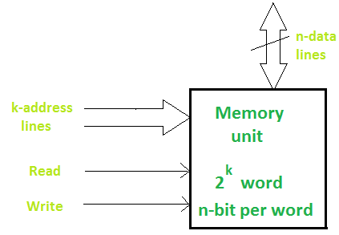
Memory
A memory unit consists of data lines, address selection lines, and control lines that specify the direction of transfer. The block diagram of a memory unit is shown below:
Data lines provide the information to be stored in memory. The control inputs specify the direction transfer.
The k-address lines specify the word chosen. When there are k address lines, 2^{k} memory word can be accessed.
Amit Yadav Computer Organization and Architecture

Slide 19
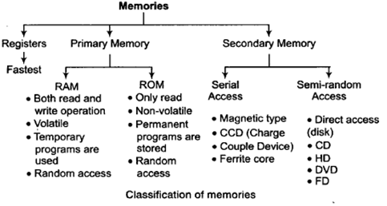
Classification of Memory
Amit Yadav Computer Organization and Architecture

Slide 20
Memory Hierarchy
The memory hierarchy system consists of all storage devices contained in a computer system from the slow Auxiliary Memory to fast and to smaller Cache memory and Register.
Auxiliary memory access time is generally 1000 times that of the main memory, hence it is at the bottom of the hierarchy.
The Memory Hierarchy was developed based on a program behavior known as locality of references.
Amit Yadav Computer Organization and Architecture

Slide 21
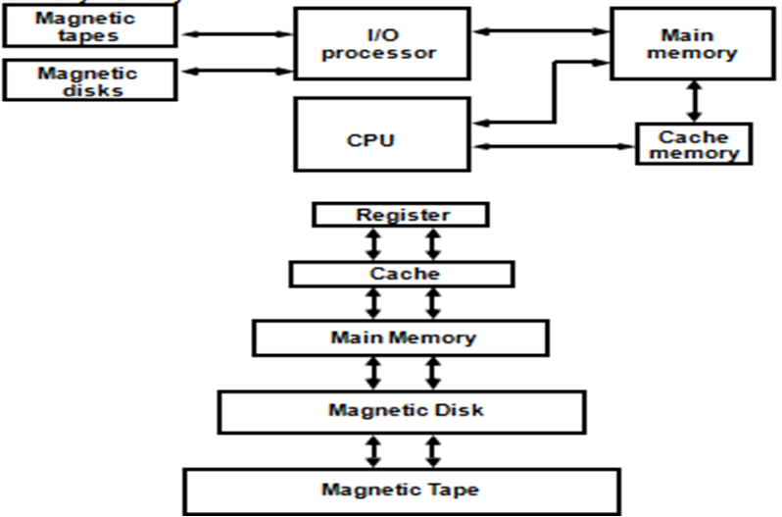
Memory Hierarchy
Amit Yadav Computer Organization and Architecture

Slide 22
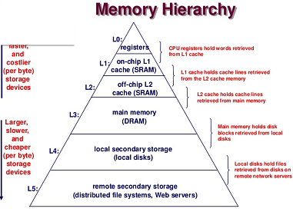
Memory Hierarchy
Amit Yadav Computer Organization and Architecture

Slide 23
Semiconductor RAM
RAM (Random Access Memory) is a part of computer’s Main Memory which is directly accessible by CPU.
RAM is used to Read and Write data into it which is accessed by CPU randomly. RAM is volatile in nature.
RAM is used to store the data that is currently processed by the CPU.
Integrated RAM chips are available in two form:
SRAM(Static RAM)
DRAM(Dynamic RAM)
Amit Yadav Computer Organization and Architecture

Slide 24
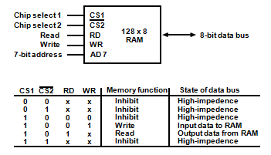
Semiconductor RAM
The block diagram of RAM chip is given below.
Amit Yadav Computer Organization and Architecture

Slide 25
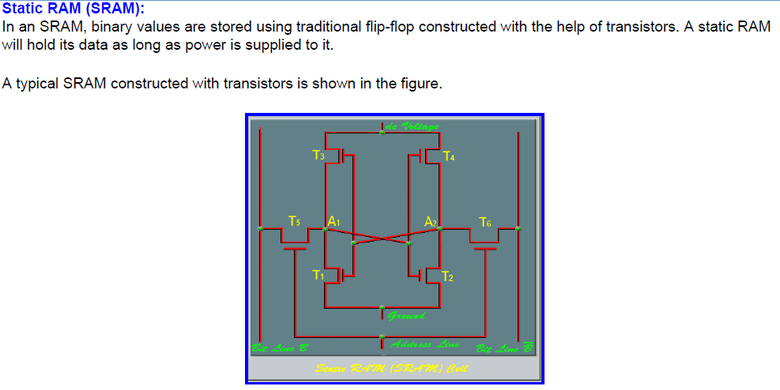
SRAM
Amit Yadav Computer Organization and Architecture

Slide 26
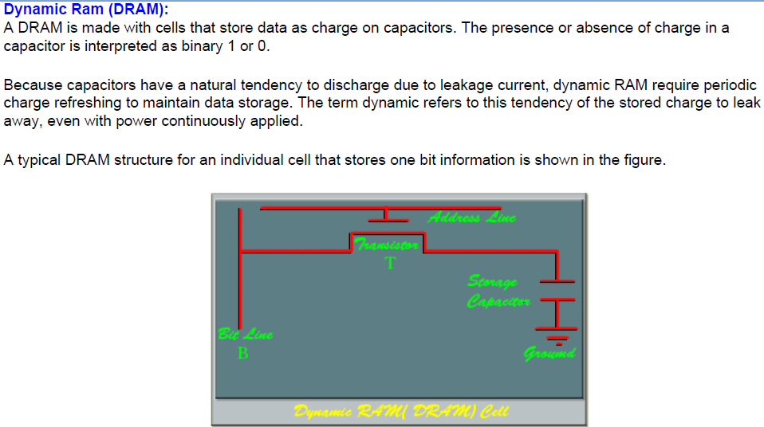
DRAM
Amit Yadav Computer Organization and Architecture

Slide 27
DRAM
Amit Yadav Computer Organization and Architecture

Slide 28
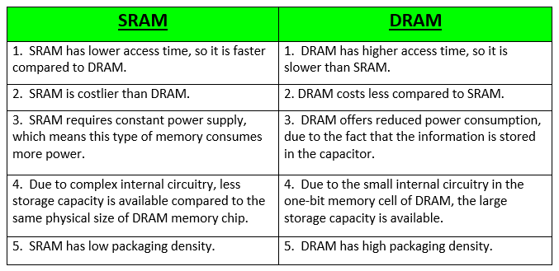
SRAM Vs. DRAM
The block diagram of RAM chip is given below.
Amit Yadav Computer Organization and Architecture

Slide 29
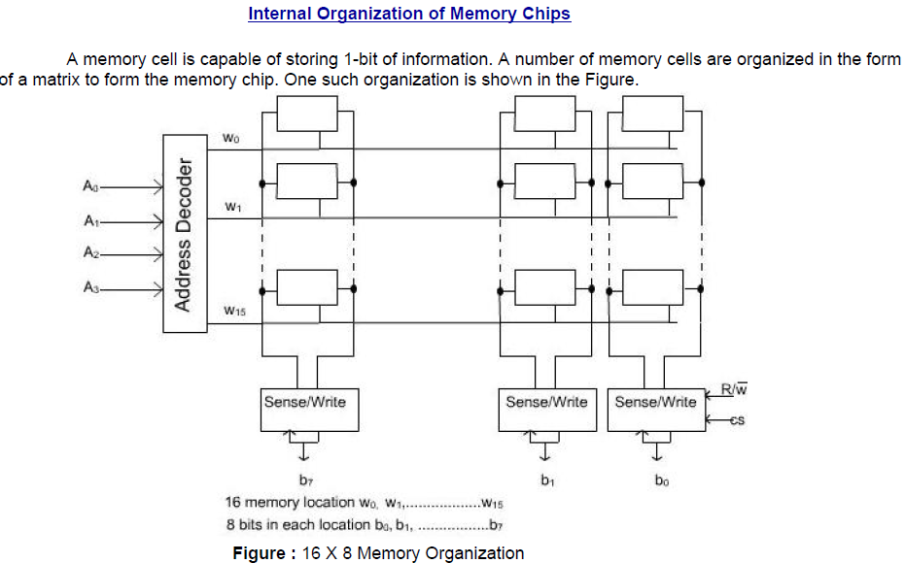
Organization of Memory Chips
Amit Yadav Computer Organization and Architecture

Slide 30
2D and 2.5D Memory organization
2D Memory organization
In 2D organization memory is divides in the form of rows and columns. Each row contains a word now in this memory organization there is a decoder.
A decoder is a combinational circuit which contains n input lines and 2^{n} output lines.
One of the output line will select the row which address is contained in the MAR.
The word which is represented by the row that will get selected and either read or write through the data lines.
Amit Yadav Computer Organization and Architecture

Slide 31
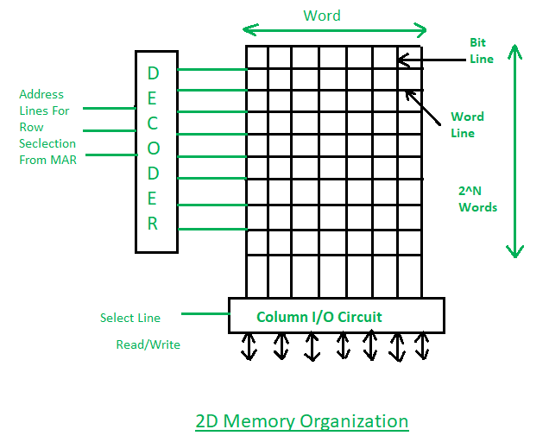
2D and 2.5D Memory organization
2D Memory organization
Amit Yadav Computer Organization and Architecture

Slide 32
2D and 2.5D Memory organization
2.5 D Memory organization
In 2.5D Organization the scenario is the same but we have two different decoders one is column decoder and another is row decoder.
Column decoder used to select the column and row decoder is used to select the row. Address from the MAR will go in decoders’ input.
Decoders will select the respective cell. Through the bit outline, the data from that location will be read or through the bit in line data will be written at that memory location.
Amit Yadav Computer Organization and Architecture

Slide 33
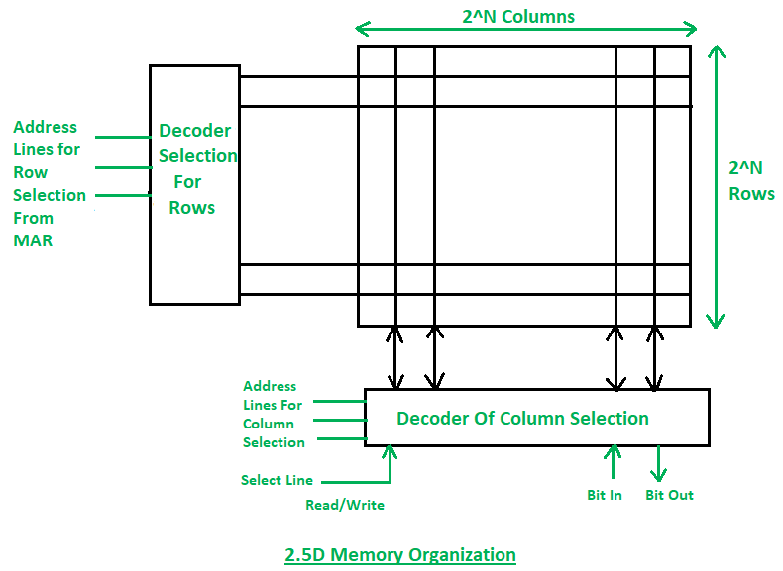
2D and 2.5D Memory organization
2.5D Memory organization
Amit Yadav Computer Organization and Architecture

Slide 34
2D and 2.5D Memory organization
Read and Write Operations
If the select line is in Read mode then the Word/bit which is represented by the MAR that will be coming out to the data lines and get read.
If the select line is in write mode then the data from memory data register (MDR) will go to the respective cell which is addressed by the memory address register (MAR).
With the help of the select line the data will get selected where the read and write operations will take place.
Amit Yadav Computer Organization and Architecture

Slide 35
2D and 2.5D Memory organization
Comparison between 2D & 2.5D Organizations
In 2D organization hardware is fixed but in 2.5D hardware changes.
2D Organization requires more no. of Gates while 2.5D requires less no. of Gates.
2D is more complex in comparison to the 2.5D Organization.
Error correction is not possible in the 2D organization but In 2.5D error correction is easy.
2D is more difficult to fabricate in comparison to the 2.5D organization.
Amit Yadav Computer Organization and Architecture

Slide 36
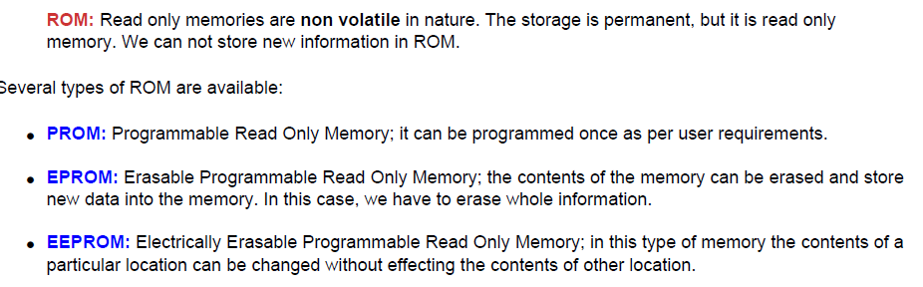
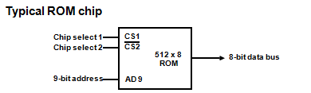
ROM Memory
Amit Yadav Computer Organization and Architecture

Slide 37
ROM Memory
Internal Structure of ROM:
The internal structure comprises two basic components: decoder and OR gates.
A decoder is a circuit that decodes an encoded form (such as binary coded decimal, BCD) to a decimal form. So, the input is in binary form, and the output is its decimal equivalent.
All the OR gates present in the ROM will have outputs of the decoder as their output.
Let us take an example of 64 x 4 ROM. The structure is shown in the following image.
Amit Yadav Computer Organization and Architecture

Slide 38
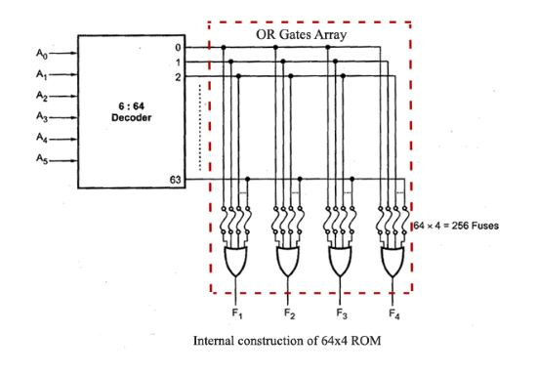
ROM Memory
Amit Yadav Computer Organization and Architecture

Slide 39
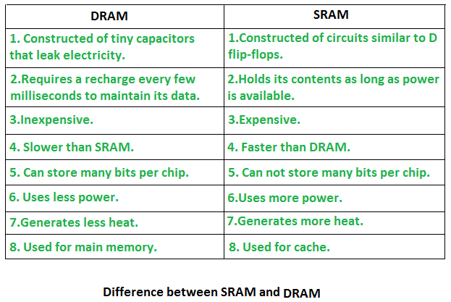
RAM Vs.ROM
Amit Yadav Computer Organization and Architecture

Slide 40
Cache Memory
Cache Memory is a special very high-speed and small memory. It is used to speed up and synchronizing with high-speed CPU.
Cache memory is costlier than main memory or disk memory but economical than CPU registers.
Cache memory acts as a buffer between RAM and the CPU. It holds frequently requested data and instructions so that they are immediately available to the CPU when needed.
Cache memory is used to reduce the average time to access data from the Main memory.
The cache stores copies of the data from frequently used main memory locations.
There are various different independent caches in a CPU, which store instructions and data.
Amit Yadav Computer Organization and Architecture

Slide 41
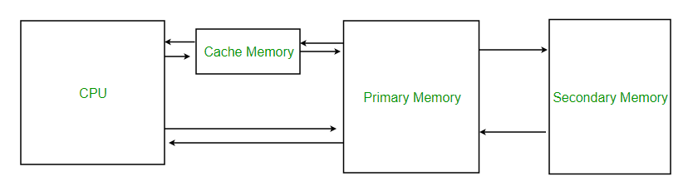
Cache Memory
Position of cache memory
Cache Performance: When the processor needs to read or write a location in main memory, it first checks for a corresponding entry in the cache.
  If available in the cache, a cache hit otherwise cache miss
For a cache miss, the cache allocates a new entry and copies in data from main memory, then the request is fulfilled from the contents of the cache.
Hit ratio = hit / (hit + miss)
Amit Yadav Computer Organization and Architecture

Slide 42
Cache Memory
Types of Cache
There are two types of cache memory-
Primary Cache
A primary cache is always located on the processor chip. This cache is small and its access time is comparable to that of processor registers.
It is referred to as the level 1 (L1) cache.
Secondary Cache
Secondary cache is placed between the primary cache and the rest of the memory. It is referred to as the level 2 (L2) cache. Often, the Level 2 cache is also housed on the processor chip.
Amit Yadav Computer Organization and Architecture

Slide 43
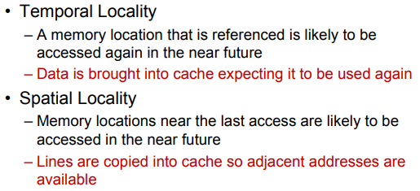
Cache Memory
Locality of reference
Since size of cache memory is less as compared to main memory. So to check which part of main memory should be given priority and loaded in cache is decided based on locality of reference.
Amit Yadav Computer Organization and Architecture

Slide 44
Cache Memory Mapping
Cache Mapping:
There are three different types of mapping used for the purpose of cache memory which are as follows:
Associative mapping
Direct mapping
Set-Associative mapping.
Amit Yadav Computer Organization and Architecture

Slide 45
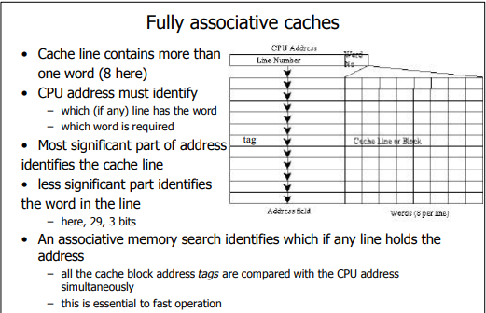
Cache Memory Mapping
Amit Yadav Computer Organization and Architecture

Slide 46
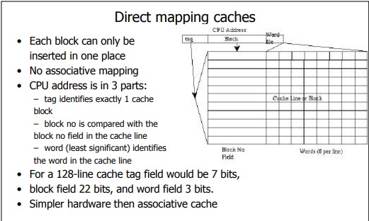
Cache Memory Mapping
Amit Yadav Computer Organization and Architecture

Slide 47
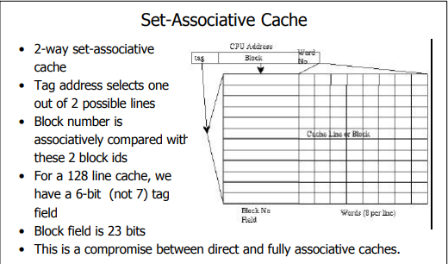
Cache Memory Mapping
Amit Yadav Computer Organization and Architecture

Slide 48
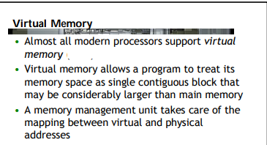
Virtual Memory
Amit Yadav Computer Organization and Architecture

Slide 49
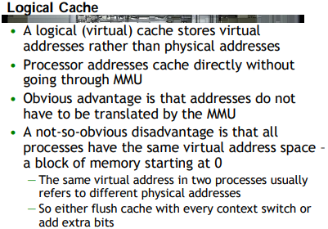
Virtual Memory
Amit Yadav Computer Organization and Architecture

Slide 50
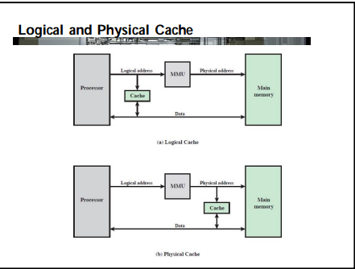
Virtual Memory
Amit Yadav Computer Organization and Architecture

Slide 51
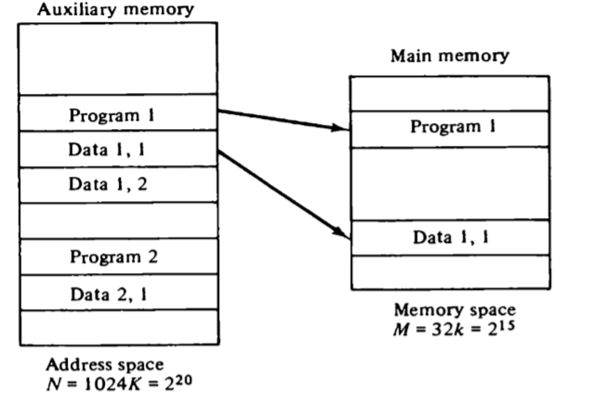
Virtual Memory
Amit Yadav Computer Organization and Architecture

Slide 52
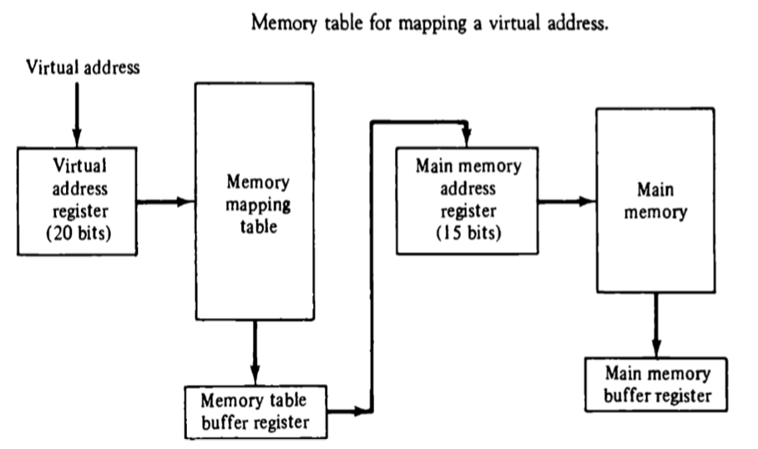
Virtual Memory
Amit Yadav Computer Organization and Architecture

Slide 53
Page Replacement Algorithm
Page replacement is a process of swapping out an existing page from the frame of a main memory and replacing it with the required page.
Page Replacement Algorithms-
Page replacement algorithms help to decide which page must be swapped out from the main memory to create a room for the incoming page.
FIFO Page Replacement Algorithm
LIFO Page Replacement Algorithm
LRU Page Replacement Algorithm
Optimal Page Replacement Algorithm
A good page replacement algorithm is one that minimizes the number of page faults.
Amit Yadav Computer Organization and Architecture

Slide 54
Page Replacement Algorithm
FIFO Page Replacement Algorithm-
As the name suggests, this algorithm works on the principle of “First in First out“.
It replaces the oldest page that has been present in the main memory for the longest time. It is implemented by keeping track of all the pages in a queue.
Example
A system uses 3 page frames for storing process pages in main memory. It uses the FIFO page replacement policy. Assume that all the page frames are initially empty. What is the total number of page faults, hit ratio and miss ratio and page reference string given below-
4 , 7, 6, 1, 7, 6, 1, 2, 7, 2
Amit Yadav Computer Organization and Architecture

Slide 55
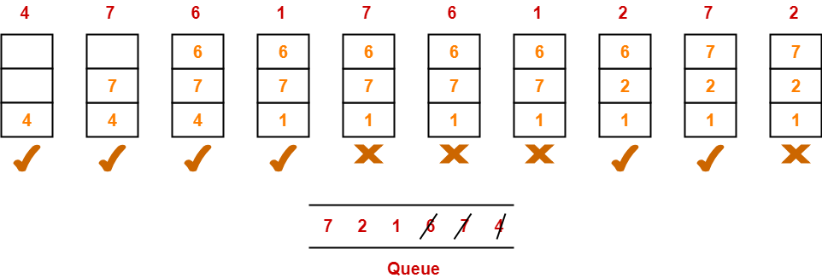
FIFO Replacement Algorithm
Solution-
Total number of references = 10
Total number of page faults occurred = 6
Total number of page hits
= Total number of references – Total number of page misses or page faults
= 10 – 6 = 4
Thus, Hit ratio = 4 / 10 = 0.4 or 40%, Miss ratio = 6 / 10 = 0.6 or 60%
Amit Yadav Computer Organization and Architecture

Slide 56
LIFO Page Replacement Algorithm
LIFO Page Replacement Algorithm-
This algorithm works on the principle of “Last in First out“.
It replaces the newest page that arrived at last in the main memory.
It is implemented by keeping track of all the pages in a stack.
Example
A system uses 3 page frames for storing process pages in main memory. It uses the LIFO page replacement policy. Assume that all the page frames are initially empty. What is the total number of page faults, hit ratio and miss ratio and page reference string given below-
4 , 7, 6, 1, 7, 6, 1, 2, 7, 2
Amit Yadav Computer Organization and Architecture

Slide 57
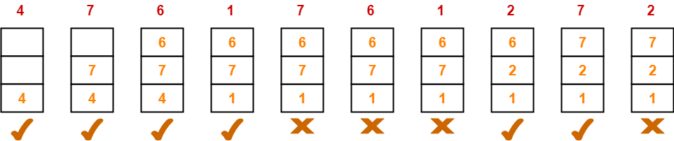
LIFO Page Replacement Algorithm
Solution-
Total number of references = 10
Total number of page faults occurred = 6
Total number of page hits
= Total number of references – Total number of page misses or page faults
= 10 – 6 = 4
Thus, Hit ratio = 4 / 10 = 0.4 or 40%, Miss ratio = 6 / 10 = 0.6 or 60%
Amit Yadav Computer Organization and Architecture

Slide 58
Optimal Replacement Algorithm
Optimal Page Replacement Algorithm-
This algorithm replaces the page that will not be referred by the CPU in future for the longest time.
It is practically impossible to implement this algorithm.
However, it is the best known algorithm and gives the least number of page faults.
Hence, it is used as a performance measure criterion for other algorithms.
Example
A system uses 3 page frames for storing process pages in main memory. It uses the Optimal page replacement policy. Assume that all the page frames are initially empty. What is the total number of page faults, hit ratio and miss ratio and page reference string given below-
4 , 7, 6, 1, 7, 6, 1, 2, 7, 2
Amit Yadav Computer Organization and Architecture

Slide 59
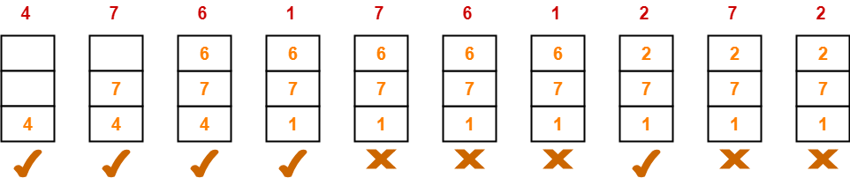
Optimal Page Replacement Algorithm
Solution-
Total number of references = 10
Total number of page faults occurred = 5
Total number of page hits
= Total number of references – Total number of page misses or page faults
= 10 – 5 = 5
Thus, Hit ratio = 5 / 10 = 0.5 or 50%, Miss ratio = 5 / 10 = 0.5 or 50%
Amit Yadav Computer Organization and Architecture

Slide 60
Auxiliary Memories
Auxiliary memory (also referred to as secondary storage) is the non-volatile memory lowest-cost, highest-capacity, and slowest-access storage in a computer system.
It is where programs and data kept for long-term storage or when not in immediate use. It is not directly accessible by the CPU. For example:
Magnetic disks and tapes, Optical Disk.
Secondary Storage Media
There are the following main types of storage media:
1. Magnetic storage media:
Magnetic media is coated with a magnetic layer which is magnetized in clockwise or anticlockwise directions. When the disk moves, the head interprets the data stored at a specific location in binary 1s and 0s at reading.
Examples: hard disks, floppy disks and magnetic tapes.
Amit Yadav Computer Organization and Architecture

Slide 61
Auxiliary Memories
Floppy Disk: A floppy disk is a flexible disk with a magnetic coating on it. It is packaged inside a protective plastic envelope.
Hard disk: A hard disk consists of one or more circular disks called platters which are mounted on a common spindle. Each surface of a platter is coated with a magnetic material.
2. Optical storage media
In optical storage media information is stored and read using a laser beam. The data is stored as a spiral pattern of pits and ridges denoting binary 0 and binary 1.
Examples: CDs and DVDs
Compact Disk: A Compact Disc drive(CDD) is a device that a computer uses to read data that is encoded digitally on a compact disc(CD). A compact disk or CD can store approximately 650 to 700 megabytes of data.
Amit Yadav Computer Organization and Architecture

Slide 62
Auxiliary Memories
DVD:
It stands for Digital Versatile Disk or Digital Video Disk. It looks just like a CD and use a similar technology as that of the CDs but allows tracks to be spaced closely enough to store data that is more than six times the CD’s capacity.
It is a significant advancement in portable storage technology. A DVD holds 4.7 GB to 17 GB of data.
Blue Ray Disk:
This is the latest optical storage media to store high definition audio and video. It is similar to a CD or DVD but can store up to 27 GB of data on a single layer disk and up to 54 GB of data on a dual layer disk.
While CDs or DVDs use red laser beam, the blue ray disk uses a blue laser to read/write data on a disk.
Amit Yadav Computer Organization and Architecture

Slide 63
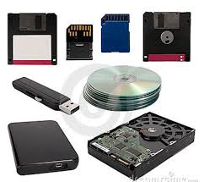
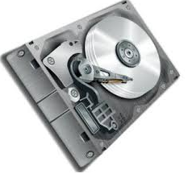


Auxiliary Memories
Example of Auxiliary Memories
DVD
CD
Hard Disk
Amit Yadav Computer Organization and Architecture

Slide 64
Faculty Video Links, You tube Courses Details
You tube/other Video Links
https://www.youtube.com/watch?v=NVUWlO5zsk0
https://www.youtube.com/watch?v=zwovvWfkuSg
https://www.youtube.com/watch?v=m1dA7D6c3C0
https://www.youtube.com/watch?v=o2_iCzS9-ZQ
https://www.youtube.com/watch?v=pJ6qrCB8pDw&list=PLIY8eNdw5tW-BxRY0yK3fYTYVqytw8qhp
Amit Yadav Computer Organization and Architecture

Slide 65
Daily Quiz
Sketch memory hierarchy .
Sketch 2.5D RAM organization.
Write some differences between SRAM and DRAM.
What do mean by virtual memory in COA.
Which page replacement algorithm is good & why ?
Amit Yadav Computer Organization and Architecture

Slide 66
Weekly Assignment
Explain memory hierarchy with suitable diagram.
Analysis different mapping scheme of cache memory.
Discuss 2 D RAM and 2+1/2D RAM with suitable diagram.
Write short notes on-
a) Cache Memory b) Associative Memory c) Auxiliary Memory
Explain the method to improve the performance of cache memory.
Amit Yadav Computer Organization and Architecture

Slide 67
MCQ
1 Which of the following is the fastest means of memory access for CPU?
a) Registers b) Cache c) Main memory d) Virtual Memory
2. Size of the ____memory mainly depends on the size of the address bus.
a) Main b) Virtual c) Secondary d) Cache
3. What is the location of the internal registers of CPU?
a) Internal b) On-chip c) External d) Motherboard
4. MAR stands for ___________
5. Which of the following is non-volatile storage?
a) Backup b) Secondary c) Primary d) Cache
6. Which of the following is used in main memory?
a) SRAM b) DRAM c) PRAM d) DDR
7. RAID stands for __________
Solution 1 b. 2a. 3 b. 4 Memory address register. 5 b 6 b
7 Redundant array of independent disks
Amit Yadav Computer Organization and Architecture

Slide 68
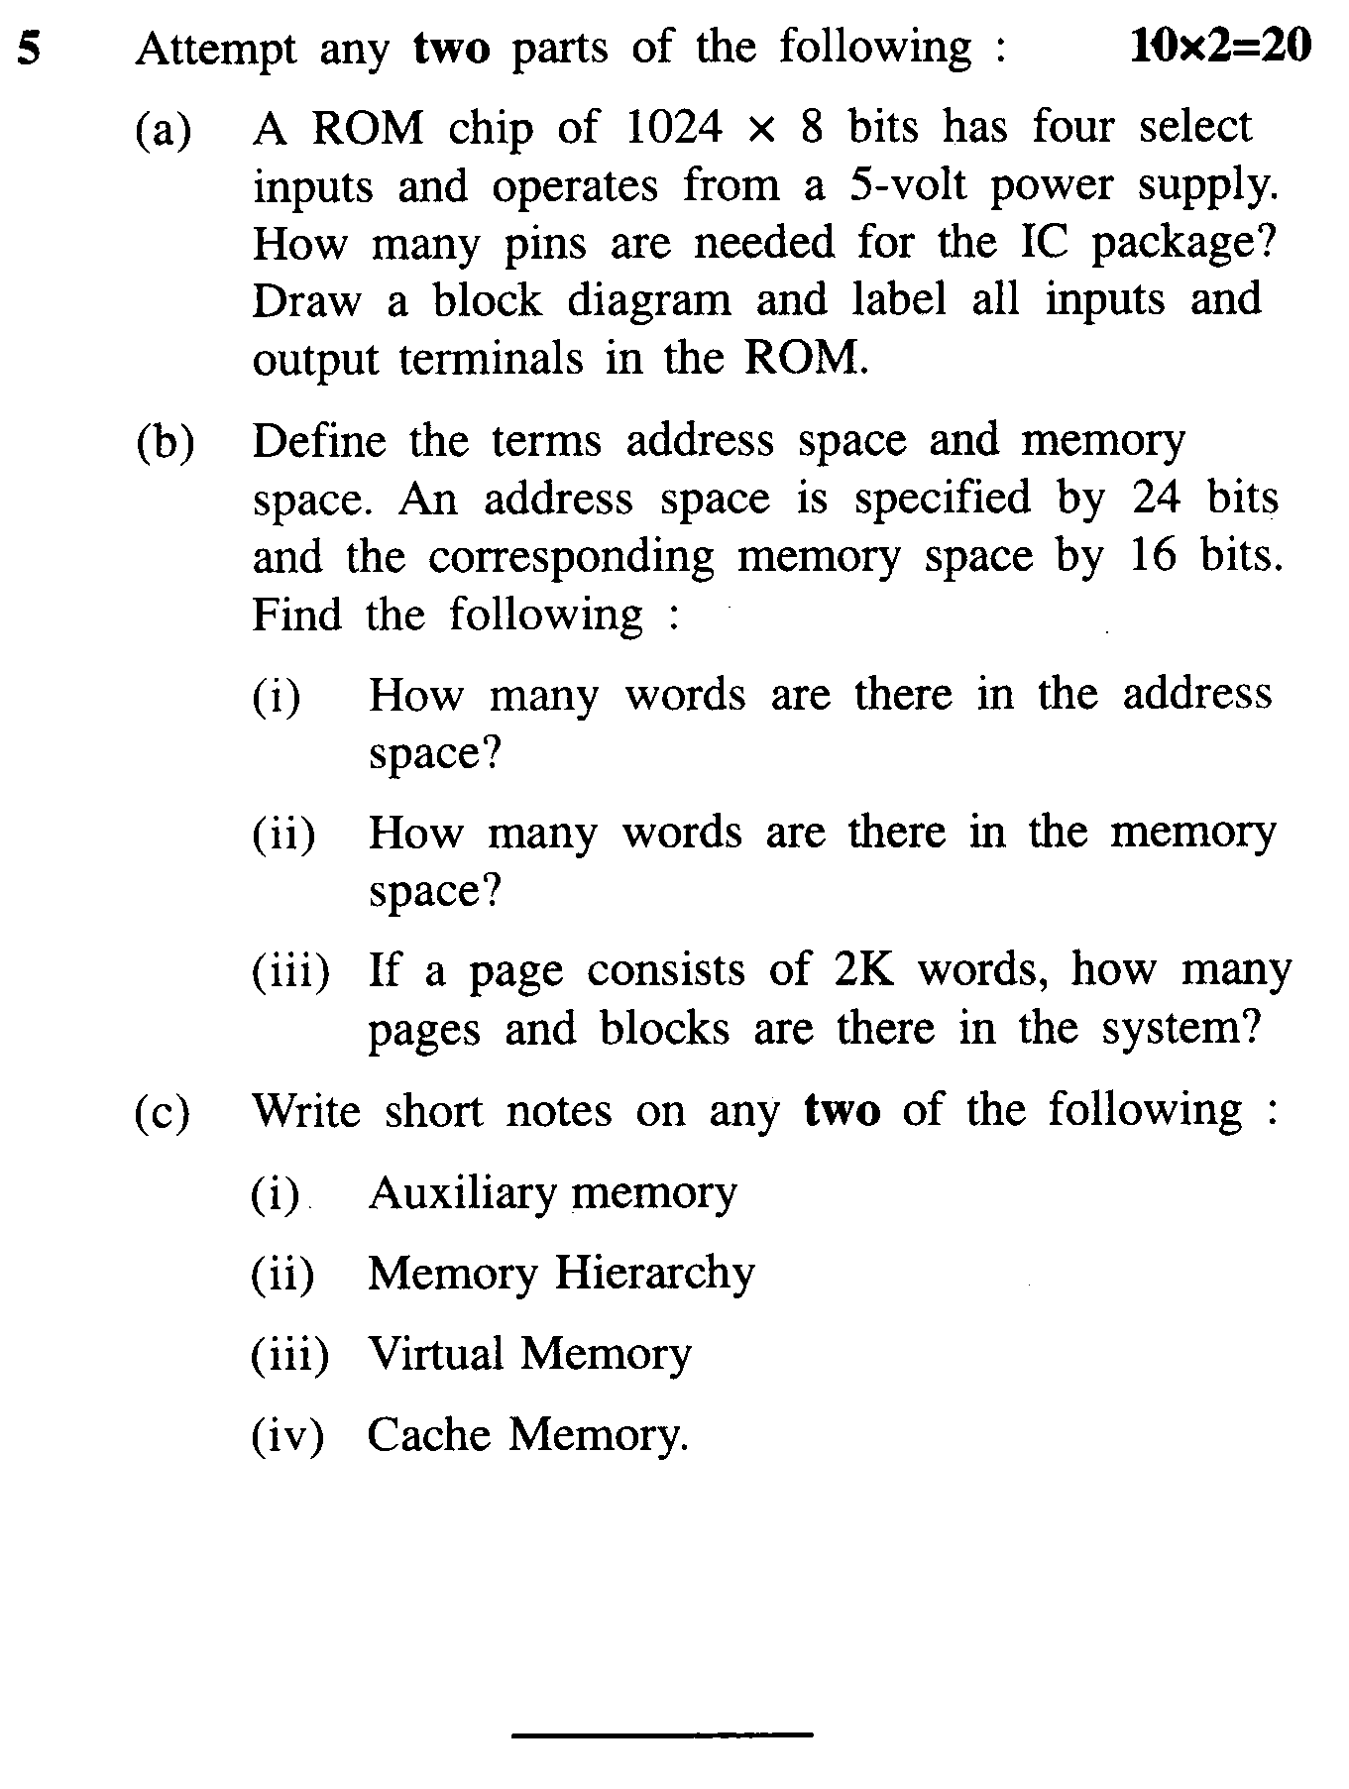
Old Question Papers
Amit Yadav Computer Organization and Architecture

Slide 69
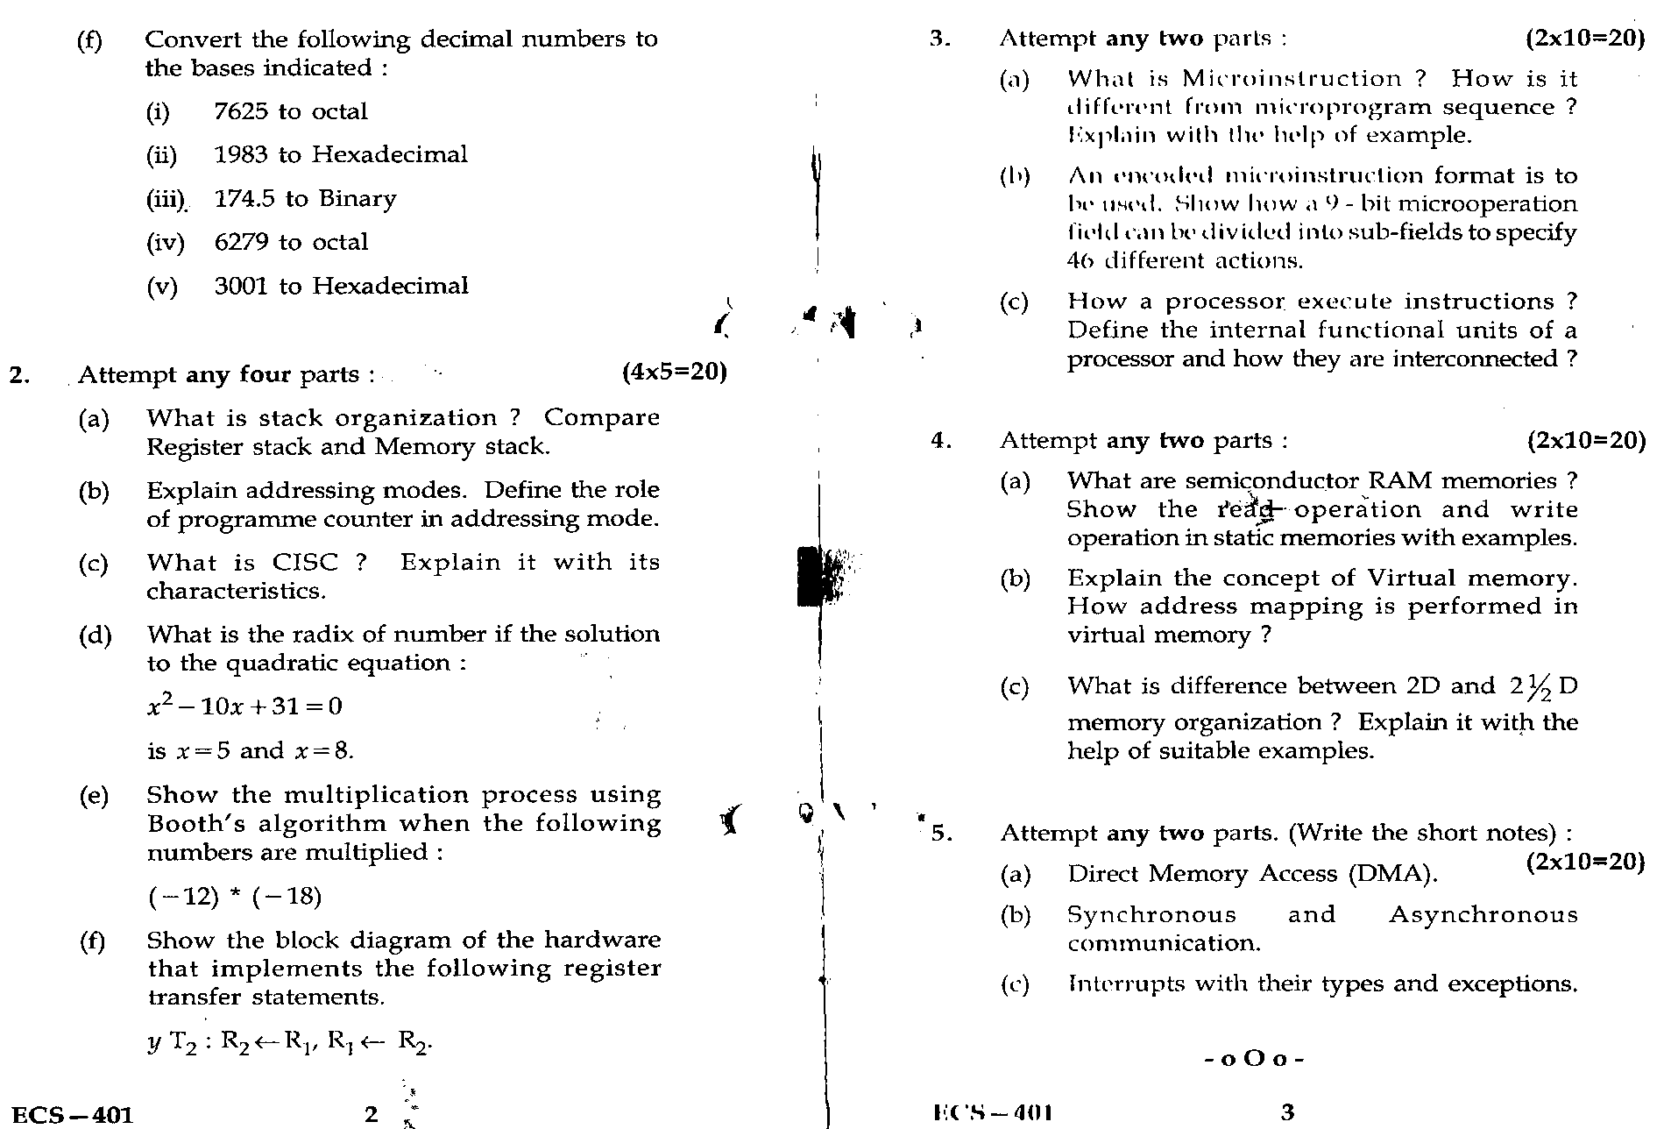
Old Question Papers
Amit Yadav Computer Organization and Architecture

Slide 70
Expected Questions for University Exam
Describe CAM in memory unit with major characteristics
with suitable diagram.
A computer uses RAM chips of 1024*1 capacity.
i) How many chips are needed & how should their address lines be
connected to provide a memory capacity of 1024*8 ?
ii) How many chips are needed to provide a memory capacity of
16KB ?
Calculate the page fault for a given string with the help of LRU & FIFO
page replacement algorithm, Size of frames = 4 and
string 1 2 3 4 2 1 5 6 2 1 2 3 7 6 3 2 1 2 3 6
Explain Memory hierarchy with suitable diagram.
Define Direct and Set associative mapping in a cache memory.
Amit Yadav Computer Organization and Architecture

Slide 71
Summary
In previous slides we discuss in details
Memory Unit:
Basic concept and hierarchy
semiconductor RAM memories
2D & 2 1/2D memory organization
ROM memories
Cache memories: concept and design issues & performance
address mapping and replacement
Auxiliary memories: magnetic disk, magnetic tape and
optical disks
Virtual memory: concept implementation
Amit Yadav Computer Organization and Architecture

